Slide 1
WTE SD model Biogas from Ag Sources – CAFOs Summarized from Murray et al. 2014
12/9/15

Slide 2
Biogas Landscape from Animal Operations
Maximum biogas potential from animal operations: circa 1,700,000 MMBtu/day at $20/MMBtu (1 M3 = 35,310.7 Btu)
Few animal producers have AD installed.
Dairy = 82% (plug flow 83%, complete mix 50%)
Beef = 1% (plug flow 100%)
Swine = 12% (covered lagoon 56%, complete mix 30%)
Cattle = ??

Slide 3
Types and Classes of Operations
Type of operation is based on the animal.
Cattle – 89,300,000 head (2012)
Dairy – 9,200,000 head (2012)
Beef – 29,300,000 head (2012)
Swine – 65,900,000 head (2012)
Operations are classified by number of head. Murray does not use operations with < 500 head in their resource assessment.
From table 6 (p. 19) it seems that 3 size classes are appropriate.
Small: 500 – 999 head
Medium: 1000 – 1999 head
Large: 2000 or greater

Slide 4
There are 3 types of AD processes with different TEA
See Table 6 for TEA details
Covered lagoon: $599,566 + $400 * head * 0.31(swine, beef)
Complete mix: $320,864 + 563 * head * 0.31(swine, beef)
Plug flow: $566,006 + 617 * head * 0.31(swine, beef)
If a producer does decide to convert manure to biogas, they can do the following:
Send it to a centralized processing facility
Process and compress it on-site
Generate electricity

Slide 5
Biogas Market for Animal Producers
At $5-6/MMBtu biogas (all sources) can supply 3-5% of the natural gas demand. In 2012 the NG market was 25,502,251 MMcf.
Market signals are insufficient to spur widespread adoption of AD systems in animal operations.
Biogas from animal operations may be eligible for RINs and RECs.
Policy incentives such as loan guarantees, FCI grants, production tax credits, and carbon taxes/cap-and-trade are
Murray et al. suggest that emissions allowances such as those used in CA ($10 – 16/ton CO2-eq) may be needed to spur adoption. See table 2 for ranges.

Slide 6
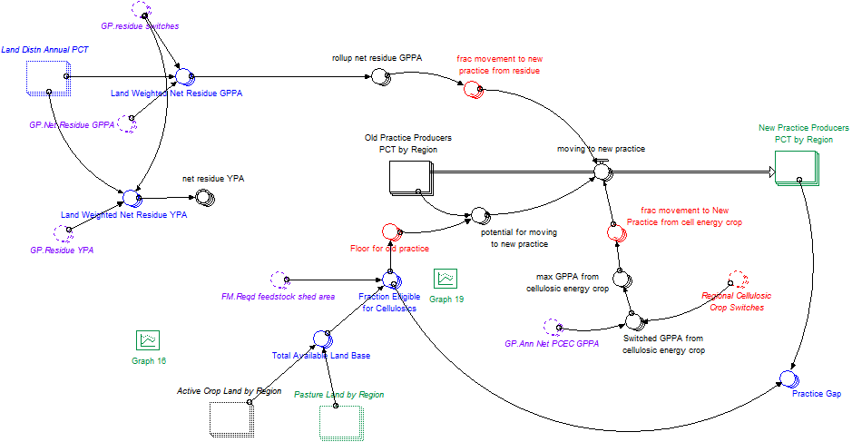
Adoption by Farmers
Modify BSM “new practice” adoption logic
2 dimensions of adoption:
Type of operation (dairy/swine/beef/cattle) by willingness (early adopter/laggard)

Slide 7
Regionalization
Animal operation data are provided, by USDA NASS, at the national and state level.
Because CA has such a different political climate, perhaps we can have a CA & RUSA region model.

